Slide 1
WHAT IS ENGLISH FOR?

Slide 2
REPLY
English is for easier communication in different countries because I don't know if you know, but most countries use English.

Slide 3
WHAT WILL BE TODAY?
Today we will see some dialogues, videos and quotes. We will learn how to order a salad, buy aquarium animals and go on a trip.

Slide 4
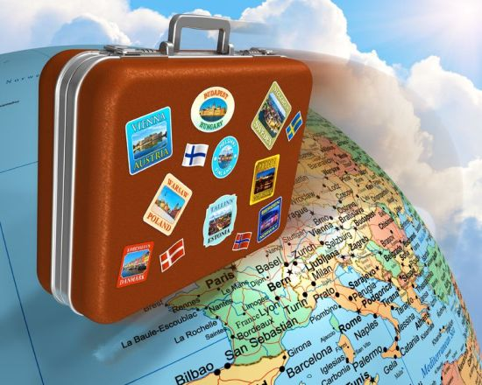
WHAT DO I NEED THIS?
Do you dream of visiting picturesque Dutch towns, but Polish travel agencies do not offer them? No problem! You are completely self-sufficient with English. Thanks to English, we can order from other countries, go to a better school and communicate with others.

Slide 5
MOVIE!!!☺
https://www.youtube.com/watch?v=128tITimwsU

Slide 6
QUIZ
https://www.quizme.pl/q/ludzikowa/sprawdz_jak_dobrze_umiesz_angielski

Slide 7
DIALOGUE SCHOOL TRIP
- I'm sorry, Miss Edwards.
- Yes what's up?
- Can I call my parents please?
-Yes of course.
- Thank you.

Slide 8
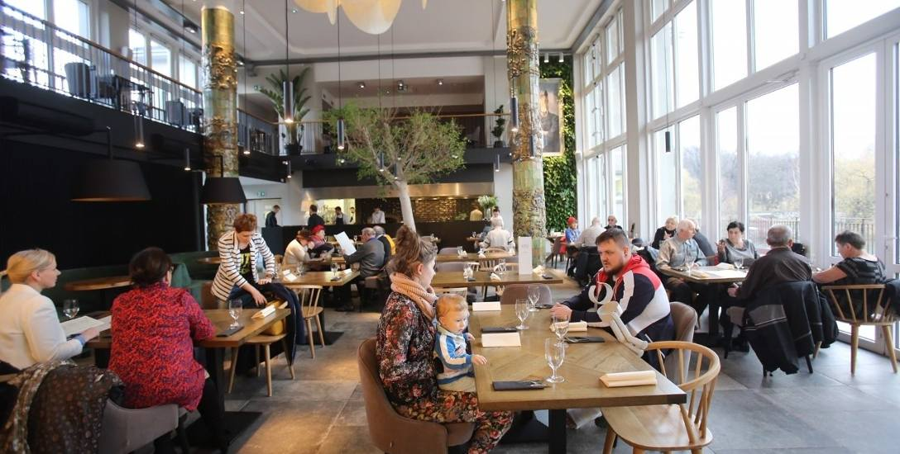
DIAOLUBE RESTAURANT
-Can I have a tomato and cucumber salad?
-I'm sorry there is no tomato and cucumber salad.

Slide 9
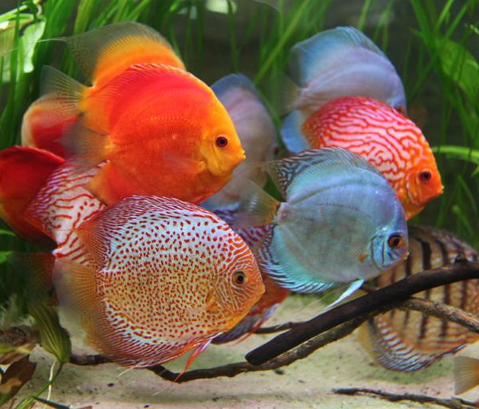
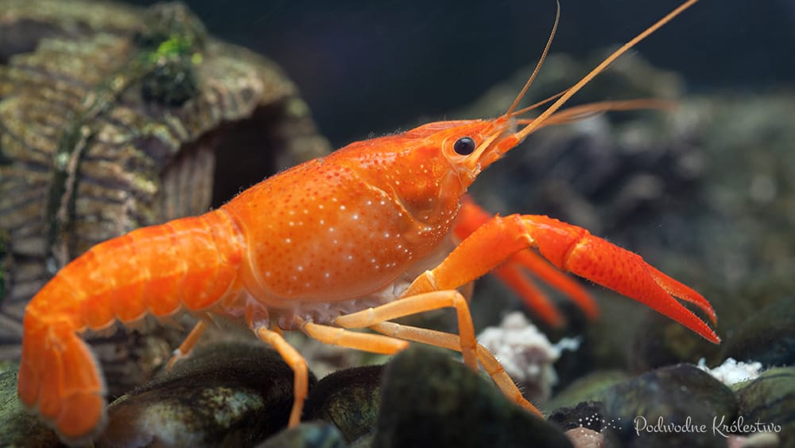
DIALOGUE ZOOLOGICAL STORE
- Excuse me, how much do fish and shrimp cost?
-They cost together 38 pounds.
And the aquarium?
With ornaments and sand 56 pounds.
Everything please. How much will I pay?
94 pounds.
Thank you, goodbye!

Slide 11
SOURCES
The pages were used when creating the presentation:
Tłumacz google
Quizme!
Yutube

